Slide 1
Macroeconomics II
Lecture 16
Industrialization and economic growth
Notes:
1

Slide 2
Theoretical Lecture 16 Industrialization and economic growth
Topics:
Limits of traditional growth models
Concerns about the nature and role of growth
Dynamic cumulative increasing returns and industrialization
How good are these models? “Food for thought”
Conclusions
Readings:
Chang, Ha-Joon (editor). 2006. Rethinking development economics. Anthem Press: London. (Chapter 2, pp. 41-60; Chapter 12, pp. 257-276; Chapter 22, pp. 499-522).
Chang, Ha-Joon. 2004. Globalization, economic development and the role of the State. Zed Books: London (Chapter 4, pp. 105-55)
Chang, Ha-Joon. 1996. The political economy of industrial policy. MacMillan Press: London
Fine, Ben. 1997. Industrial Policy and South Africa: a strategic view. NIEP Occasional Paper Series, no 5, April, Johannesburg, National Institute for Economic Policy.
Fine, Ben and Zavareth Rustomjee. 1996. The political economy of South Africa: from minerals-energy complex to industrialization. Westview Press: London [Chapters 2 (pp 19-62), 3 (pp 63-70), and 9 (pp 208-240)]
Ocampo, José and Lance Taylor. 1998. Trade liberalisation in developing countries: modest benefits but problems with productivity growth, macro prices and income distribution, Economic Journal no. 108 (September), pp. 1523-46.
Weiss, John. 1985. Manufacturing as an engine of growth – revisited. Industry and Development, 3 (pp 39-62)
2
Notes:
2

Slide 3
Limits of the traditional growth models
Traditional growth models focus on aggregate factors of growth, as general “inputs”:
Savings/Investment – expansion of physical capacity
Technological progress (exogenous or endogenous to the model)
These models do not discuss production and distribution structures, linkages, specific technologies, specific markets, firms and associated social tensions and how they affect growth, reproduction, accumulation and crises.

Slide 4
Limits of the traditional growth models
In such models, acceleration or transformation of accumulation of capital are constrained by relative factor intensity, physical capital or technological progress, depending on the model (the key point: do not move the economy away from its steady state growth path!)
Economic trajectories and distribution of income are defined within the framework of steady state growth. Given factor substitutability, it does not matter, for these models, how and what an economy produces, trades, distributes and accumulates, as long as it follows its steady state path.

Slide 5
Concerns about the nature and role of growth
Two very different types of questions/perspectives about the nature of growth:
One is concerned with the reproduction of capitalism at higher levels of wealth, of macroeconomic and environmental sustainability, with better (more equal) income distribution and social safety.
Focus on structures of economic growth and its linkages: role of different sectors; patterns of production, technological capabilities, trade and employment; diversification and articulation; finance and public policy related to productive structures.
Influenced by the debate “state vs markets” in economic development – which one, states or markets, or which combination of both, can deliver more efficient outcomes.
Looks for general blueprints – for example, general definitions of industrial policy and of the role of the state and of industrializing linkages (like, for example, in Ha-Joon Chang, Ocampo, Weiss and others).

Slide 6
Concerns about the nature and role of growth
The other is concerned with the understanding of how the capitalist economy works and can be changed, the sources of its expansion, instability and crises, and the nature of the social tensions and struggle that may reproduce or challenge capitalism.
Focus on social structures of accumulation and how agents and linkages emerge, interact and form specific political economy conditions.
Capital accumulation is the primary goal of the capitalist economy; capital accumulation is primarily a social and political issue, related to the social and technical dynamics involved in production/distribution (affecting the nature of labour and capital, as well as the relationships and tensions between labour and capital, between different groups of workers and factions of capital, the tensions about appropriation and deployment of surplus value, and so on). Labour productivity and growth patterns reflect social market/competitive conditions imposed on capital accumulation.

Slide 7
Concerns about the nature and role of growth
Key question is a historical one: how industrial capitalism, or any other form of capital accumulation, came to dominate, and how they structure states and markets and their relationship?
Whether and how an economy industrializes/de-industrializes, how that happens and what emerges from it, the nature of policy and of states and markets, depends on the social structures and patterns of production, expansion (growth), appropriation, deployment, distribution, consumption, and how the tensions associated with such structures are resolved.
Competition for profits amongst capitalists
AND
Capital/Labour struggle
Change in Technology
AND
in social organization of production
Increase in productivity AND expansion of production and employment
Rate of profits fall (extraction and realization) AND
Crisis of accumulation
Concentration and centralization of capital, repression of labour
AND
a new cycle begins

Slide 8
Dynamic/cumulative increasing returns
We focus the remaining of the lecture on the “reproduction of capitalism” perspectives, with emphais on dynamic cumulative increasing returns associated with industrialization.
Evidence for the “virtuous cycle” of growth:
↑Investment → ↑productive capacity (technology, infrastructure, scale, productivity) → ↑output → increasing returns, economies of scale and scope, higher levels of division of labour and cooperation, lower production costs → Diversification of production, complementarities/articulation between activities, higher productivity jobs → ↑ Incomes → ↑ Consumption, savings and trade → ↑Expectations → ↑ Conversion of S into I→ ↑I →… and so on…

Slide 9
Dynamic/cumulative increasing returns
Structural transformation defined as industrialization, given historical evidence – share of manufacturing in GDP and exports, production organized in firms, technological deepening, diversification/linkages in production, massification of wage labour and increase in the share of manufacturing in employment.
The rate of growth of Y determines the rate of growth of productivity, y, which, in turn, accelerates the rate of growth of Y, such that the virtuous cycle can be summarised by the dynamic nexus ↑Y →↑ y →↑Y →↑ y→ Y… (to infinity). [Question: are there limits to this process? Can you identify a few and explain how they pose limits to this process?]

Slide 10
Dynamic/cumulative increasing returns
Hence, a dynamic economy is the one that realises dynamic and cumulative increasing returns to scale: continuous and permanent reduction in costs and increase in productivity owing to continuous increase in output and industrial transformation over time. These are called “dynamic” and “cumulative” because there are continuous change (dynamic) that are built from existing capacities and are not random spikes/shocks, but structural and permanent changes (cumulative). If there is a shock (say, a war, a pandemic) that paralyses production and destroys capacities, once the shock is over it’s possible to regroup and rebuild quickly and move forward – cumulative increasing returns are not “forgotten” or “erased” because of a shock.

Slide 11
Dynamic/cumulative increasing returns
Consumer preferences for diversity in product markets do not limit gains from economies of scale: whereas new technologies and computation allow for cheaper product differentiation (economies of scope), initial capital costs of such new technologies are very high, so that gains from economies of scale are also high.

Slide 12
Mechanism of dynamic/cumulative increasing returns
…→ ↑INVESTMENT→
↑ Capital &
↑ Labour productivity
(Labour moves into higher productivity sectors)
ECONOMIC GROWTH →
↑expectations
(of ↑profits & ↑demand) →…
…→ ↑PRODUCTIVITY
(of investing firms/industries)
DUE TO…
↑
…Cross firm/industry externalities (complementarities, spillovers, networks of suppliers) +…
…+ diversification + skill accumulation + management + technological capabilities
CUMULATIVE/DYNAMIC INCREASING RETURNS
AND
DIFFERENTIATED PATTERNS OF SPECIALIZATION
…NEW TECHNOLOGY
(embodied in capital equipment)
& TO…

Slide 13
Dynamic/cumulative increasing returns
Kaldor/Verdoorn dynamic/cumulative increasing returns requires that:
1) Productivity AND employment grow (cumulative structural transformation), BUT productivity grows faster than employment (cumulative increasing returns).
…, where p, q and e are the logarithmic growth rates of productivity, output and employment.
(According to earlier studies, only in manufacturing these two results hold together, as labour productivity grows faster in manufacturing.)

Slide 14
Dynamic/cumulative increasing returns
2) the elasticity (λ) of the rate of growth of GDP (q) with respect to the rate of growth of manufacturing (mva), is bigger than the manufacturing value added (MVA) share of GDP,
(meaning that as MVA increases, GDP increases more than proportionally)
because: productivity in manufacturing increases as manufacturing expands due increasing returns; AND faster growth of productivity (and consequent lowering of production costs) in manufacturing lead to more investment and faster growth in productivity (and lowering of production costs) in the economy as a whole (including sectors outside of manufacturing, like agriculture and services, for example). So, as manufacture expands, GDP grows by the rate of that expansion times the share of manufacturing in GDP PLUS the impact of manufacturing production on every other sector (agriculture, construction, transports, communications, etc.) and on key dynamic economic nexus (such as income, savings/investment, consumption). Why?

Slide 15
Dynamic/cumulative increasing returns
Why does manufacturing growth have a more than proportional impact on economic growth?
+ technological change embodied in capital and intermediate goods generated by manufacturing and utilised elsewhere in the economy – new means of production, produced by industrial firms, which are more productive and more cost efficient/effective, are adopted and deployed in agriculture, in transportation, in fishing, in construction, in mining, in different services, etc.. So, development of manufacturing capacities enable new technologies (embodied in capital goods) that increase productivity in manufacturing and elsewhere in the economy, lower production costs in manufacturing (making its outputs more cost effective for the economy as a whole) and lowers production cost elsewhere, thus driving new investment.
+ absorption of surplus labour from elsewhere in the economy (particularly from low productivity sectors or sectors yielding decreasing returns) in manufacturing increases the marginal and average productivity of labour in the economy (as a whole).
+ increase in demand and of the scale of production (which result from higher incomes, higher productivity, lower production costs and, consequently, higher investment) result in increase in investment, output, productivity (and lower costs of production), employment, incomes, demand, scale and so on….

Slide 16
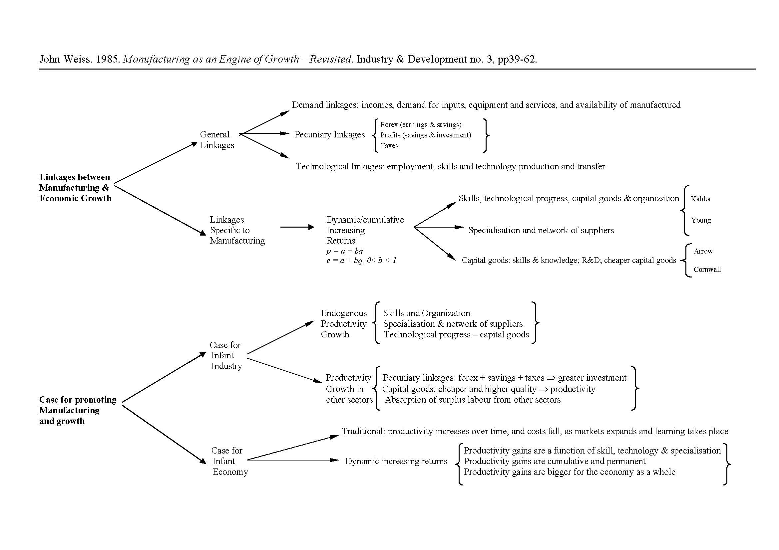
A useful summary

Slide 17
Other arguments for industrialization, which are also included in the dynamic, cumulative increasing returns
Learning
Diversification of Exports
Higher Income (Y)
Absorption/mastering of new technologies
Minimize price and revenue volatility
Higher demand, savings and investment
Diversification/expansion into dynamic/innovative markets
Learning from export experiences
Satisfaction of broader material needs in goods and services
Pool of technological capabilities (skilled workers, science/technology organizations, technology related institutions, R&D)
Create/take advantage of global chains
Significant import substitution through domestic linkages
Industrial firms, industries & networks/linkages
Balance of payments: tradable (ex, manufacturing goods) versus non tradable goods/services
Adaptation, innovation and invention

Slide 18
How good are these theories? “Food for thought”
Role of sectors is blurred: Social and scientific/technological transformation of production processes has blurred the differences between traditional sectors by transforming them and their role in the production process (for example, the role of software and AI in production – how much of this is manufacturing and how much is services?).
Unequal development of capitalism and global multinational/chains have reinforced “old” patterns of specialization (primarization of production/trade and cheap labour) in non-industrialized economies, AND have created “new” patterns of global specialization and division of labour, with relocation of standardized industries to cheap labour economies, simultaneously with concentration of scientific/technological revolutionary capabilities (such as AI and robotization) and finance in high tech economies.

Slide 19
How good are these theories? “Food for thought”
Patterns of employment (less productive, fewer jobs) and of income distribution (more unequal, with share of labour remunerations falling and of capital – in the form of profits, rents and interest – increasing)
Dominant role of financialization (another lecture): higher share of profits coming from financial speculation, higher share of profits going into financial assets, and, consequently, a lower share of surplus being deployed in real investment and innovation. Financial markets control productiona nd distribution chains. Thus, prevents innovation/productivity growth and reproduction of a productive economy.
Limits to environmental sustainability (another lecture)

Slide 20
Conclusions
Growth trajectories, speed, sustainability and transformative power are related to socioeconomic transformation, which, in the literature, is associated with industrialization
The power of industrialization arises from (a) evidence that links “virtuous” cycles to industrialization; (b) dynamic and cumulative increasing returns; (c) the social and historical nature of capital accumulation and capitalist transformation of society.
Need to reformulate theories: away from sectors (dynamic change is not only sectoral, and traditional differences between sectors are blurred) and away from exclusive focus on linkages (focus on social systems of accumulation, agent-linkages dynamics, and understanding of how capitalist economies expand and go into crisis).

